Slide 1
Random Forest

Slide 2
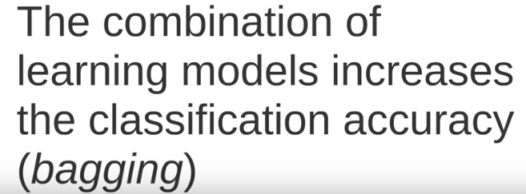
Rationale

Slide 3
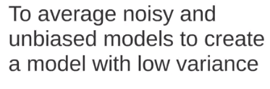
Bagging

Slide 4
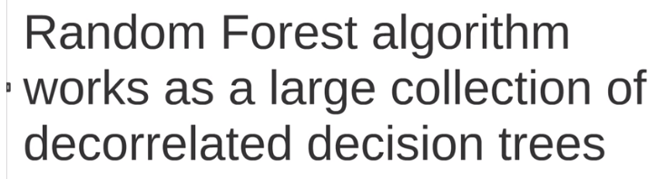
Random Forest algorithm

Slide 5
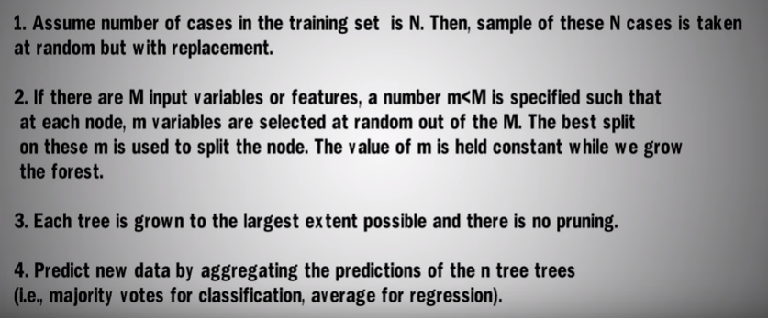
Algorithm

Slide 6
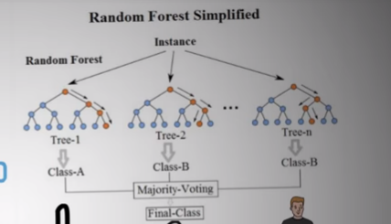
Random Forest Simplified

Slide 7
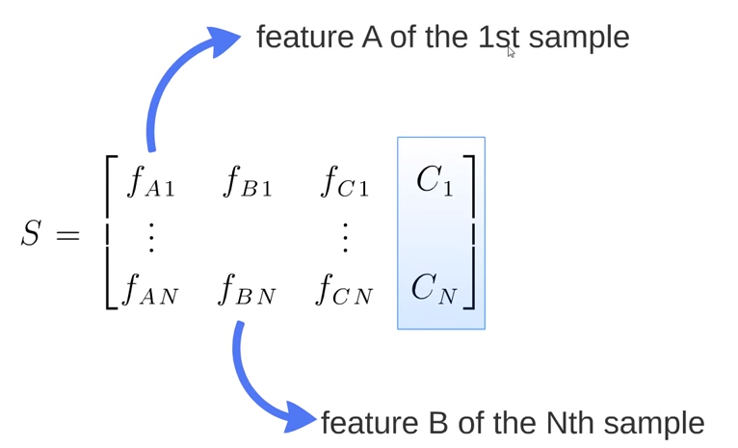
How does RF work?

Slide 8
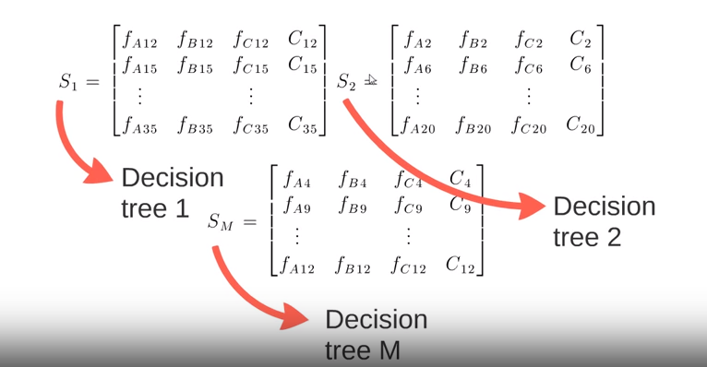
Create Random Subsets(Random Trees)

Slide 9
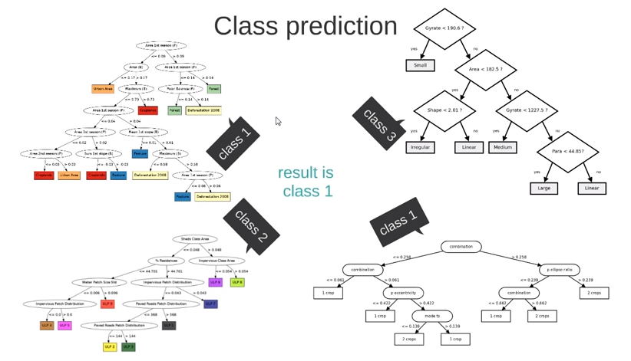
Class Prediction

Slide 10
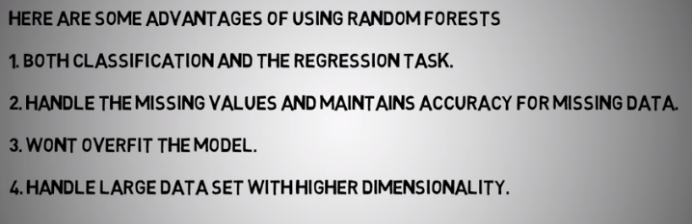
Pros

Slide 11

Cons

Slide 12
Reference
https://www.youtube.com/watch?v=D_2LkhMJcfY
https://www.youtube.com/watch?v=loNcrMjYh64

